Slide 1
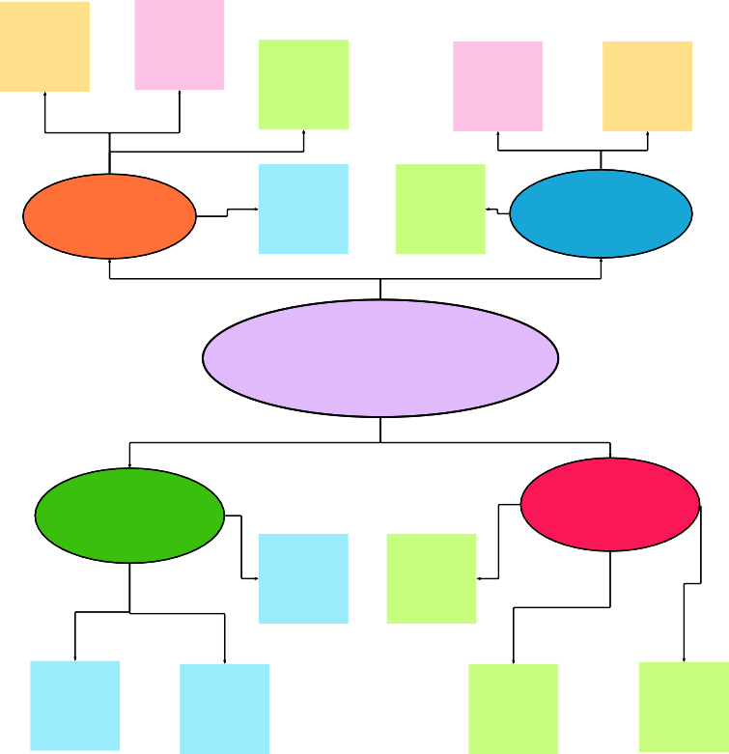
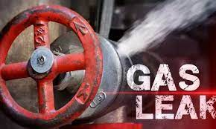
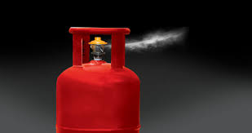

1
Define your problem statement
What problem are you trying to solve? Frame your problem as a How Might We statement. This will be the focus of your brainstorm.
2
Brainstorm
Write down any ideas that come to mind that address your problem statement.
10 minutes
3
Group ideas
Take turns sharing your ideas while clustering similar or related notes as you go. In the last 10 minutes, give each cluster a sentence-like label. If a cluster is bigger than six sticky notes, try and see if you and break it up into smaller sub- groups.
20 minutes
4
Prioritize
Your team should all be on the same page about what's important moving forward. Place your ideas on this grid to determine which ideas are important and which are feasible.
TIP
Participants can use their cursors to point at where sticky notes should go on the grid. The facilitator can confirm the spot by using the laser pointer holding the H key on the keyboard.
Before you collaborate
A little bit of preparation goes a long way with this session. Here’s what you need to do to get going.
10 minutes
After you collaborate
You can export the mural as an image or pdf to share with members of your company who might find it helpful.
TIP
You can select a sticky note and hit the pencil [switch to sketch] icon to start drawing!
TIP
Add customizable tags to sticky notes to make it easier to find, browse, organize, and categorize important ideas as themes within your mural.
5 minutes
20 minutes
Brainstorm
& idea prioritization
Use this template in your own brainstorming sessions so your team can unleash their imagination and start shaping concepts even if you're not sitting in the same room.
Group ideas
_{A} Team gathering
Define who should participate in the session and send an invite. Share relevant information or pre-work ahead.
PROBLEM STATEMENT
Quick add-ons
SANTHOSH P
LAKSHMI NARAYANAN B
AKASH RAJ M
BADHR MUHAMMED S
Sensing gas leakage using MQ sensors
Continuous recording of sensed values
_{A} Share the mural
Share a view link to the mural with stakeholders to keep them in the loop about the outcomes of the session.
arduino and sensor based gas leakage monitoring system
identifying the concentration of gas in air
Recording of values from sensor
Usage of setup in both domestic and industries
Detection of gas when change in recorded values
algorithm encryption and decryption of data of recorded values
Node MCU and sensor based gas detection
_{B} Set the goal
Think about the problem you'll be focusing on solving in the brainstorming session.
Every year there are numerous accidents due to gas leakage.
Both industrial and domestic leakage of gas might lead to such incidents
Algorithm for proper operation of sensor
B Export the mural
Export a copy of the mural as a PNG or PDF to attach to
emails, include in slides, or save in your drive.
app developing
for detecting gas using Node RED
Learn how to use the facilitation tools
The controller is interfaced with IBM Watson platform
MQ sensor is used to monitor the concentration of gas
app developing for gas detection and monitoring
C
Use the Facilitation Superpowers to run a happy and
productive session.
Domestic uses include LPG detection
10 minutes to prepare
1 hour to collaborate
2-8 people recommended
Gas detection
Sensor interfaced with Node MCU controller
Implementing a code to analyze the recorded values
Prediction and
Algorithm implementation
Keep moving forward
Strategy blueprint
Define the components of a new idea or strategy.
Open the template
Open article
IBM Watson platform to implement channel for analysis and recording of data
prefixed values in Arduino monitors the threshold of gas concentration in air.
cloud data based microcontroller node mcu used for monitoring
predicting the detection of gas leakage
Industrial use includes gas leakage and other harmful gas detection
Sensors for gas detection
MEMBERS OF THE IDEATION PROCESS:
TEAMLEAD: SANTHOSH.P
TEAM MEMBER 1: LAKSHMI NARAYANAN.B
TEAM MEMBER 2: A K A S H R A J . M
TEAM MEMBER 3: BADHR MUHAMMED.S
TODAY'S DISCUSSION TOPIC:
Customer experience journey map
Understand customer needs, motivations, and obstacles for an experience.
Open the template
The leakage of gases only can be detected by human nearby and if there are no human nearby, it cannot be detected.
But sometimes it cannot be detected by human that has a low sense of smell.
Analysis of data in a channel created in Watson platform
Algorithm implementation for working of monitoring system
Project developed using IBM watson platform
LED indication or buzzer indication for alerting
Gas Leakage monitoring and alerting system
Importance
If each of these tasks could get done without any difficulty or cost, which would have the most positive impact?
Alerting gas leakage to necessary authorities using Wi-fi
Strengths, weaknesses, opportunities & threats
MQ sensors are used to sense harmful gases
IBM cloudant service used for gas leakage monitoring
wireless network based data collection
End applications can include alerting through applications
Identify strengths, weaknesses, opportunities, and threats (SWOT) to develop a plan.
Open the template
GSM module to alert the user for gas leakage
Wifi module network to sense resultant data
Alerting authorities using Wifi when gas is detected
forming mesh network using sensor to better monitoring
In case of fire concentration of smoke particles can be sensed as well
Cloud interface
Node MCU
Interfacing sensors with controller
Share template feedback
Node MCU and sensor based gas detection and monitoring
Interfacing sensors and system together
MQ 135 or MQ2 sensors for gas detection
Concentration of gas in air is sensed
If in case of fire sprinklers etc can be activated automatically
Gas Leakage monitoring & Alerting system for Industries
Air particle concentration measurement to sense gas
Thus implementation of a gas detection and monitoring system can greatly help in reducing the accidents caused due to gas leakage.
Alerting necessary authorities when gas is detected
Other wireless means of network like LoraWAN
After detection of gas end terminals can be implemented with specific application.
Using clouds services for continuous monitoring of gases
Watson platform for online channel services
GSM modules to collect and transfer sensed data through the network
Setting up the project kit in the ideal location
Writes signals to the sensors and actuators
Share template feedback
Feasibility
Regardless of their importance, which tasks are more feasible than others? (Cost, time, effort, complexity, etc.)

